Slide 2
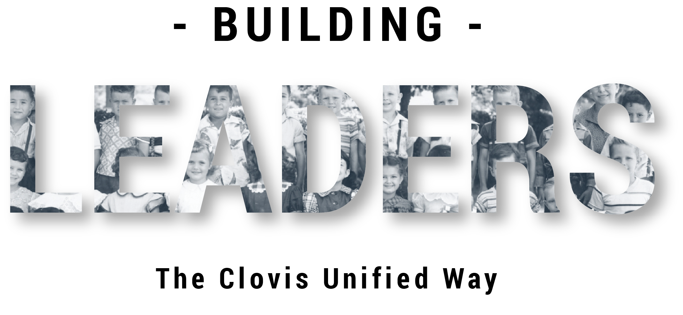
High Standards Philosophy
Notes:
Facilitator:
If this is the first-time participants are hearing about the Doc B Leadership Academy introduce the Academy. This is a great opportunity to build the “why” behind the “what” of leadership development based on the philosophies and values of Clovis Unified (script available in resource folder). If this is not the first time briefly review the purpose of the Leadership Academy.

Slide 3
Part III
Notes:
Facilitator:
Part III of each module is always an outside resource that reflects the philosophy and values we are studying. It is a deep dive into where it originated, why it is important today, and what it looks like in action. For the philosophy high standards, we will be using excerpts from four books by Jim Collins; Good to Great, Be 2.0, Built to Last, and Great by Choice (summaries of each book are available in the resource folder).

Slide 4
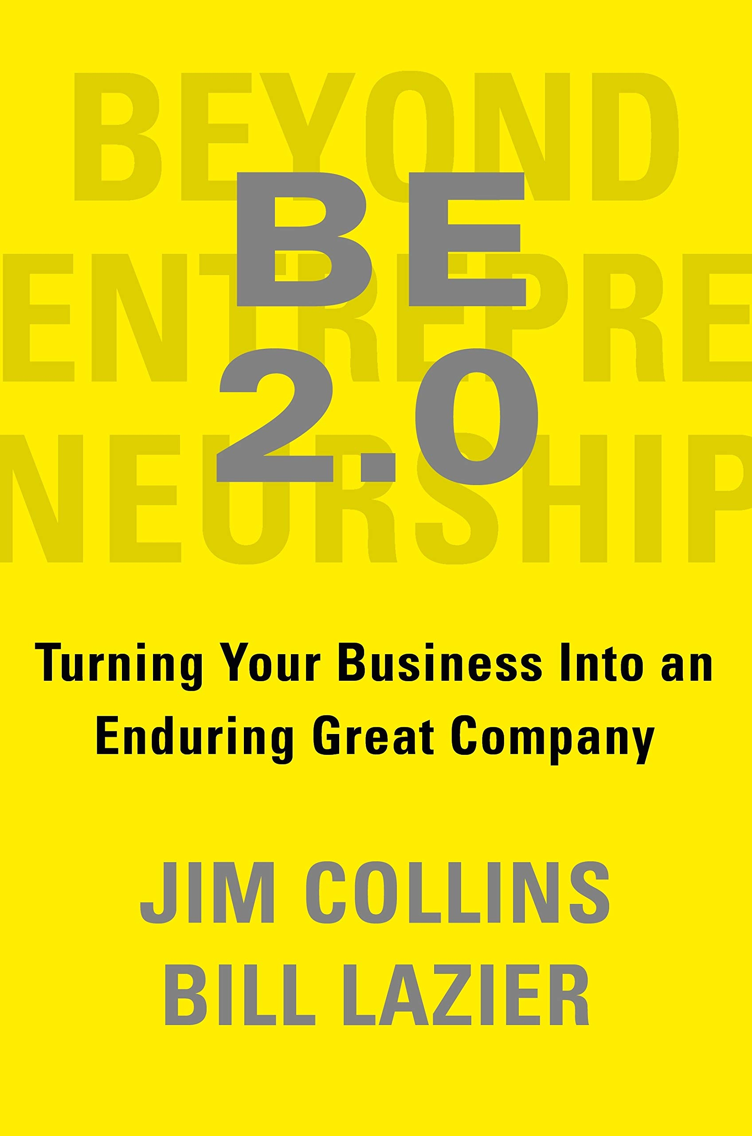
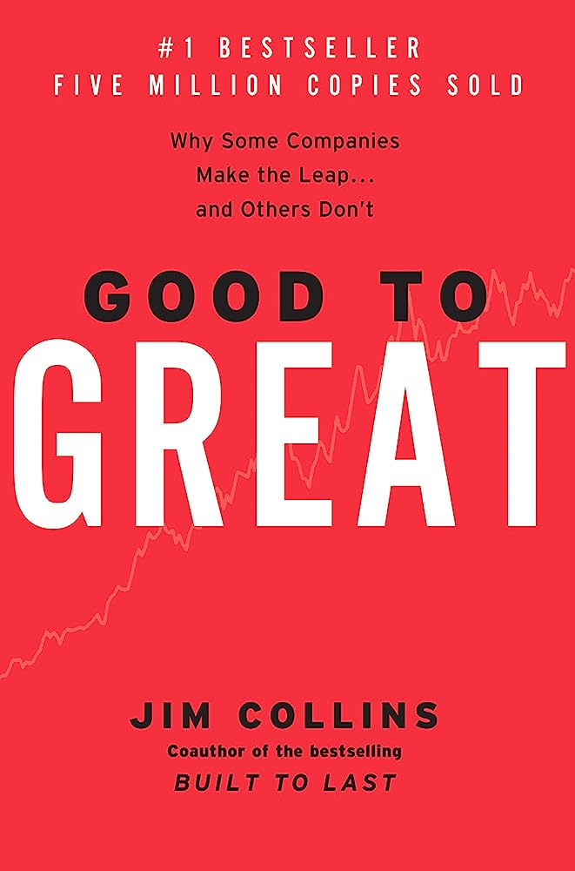
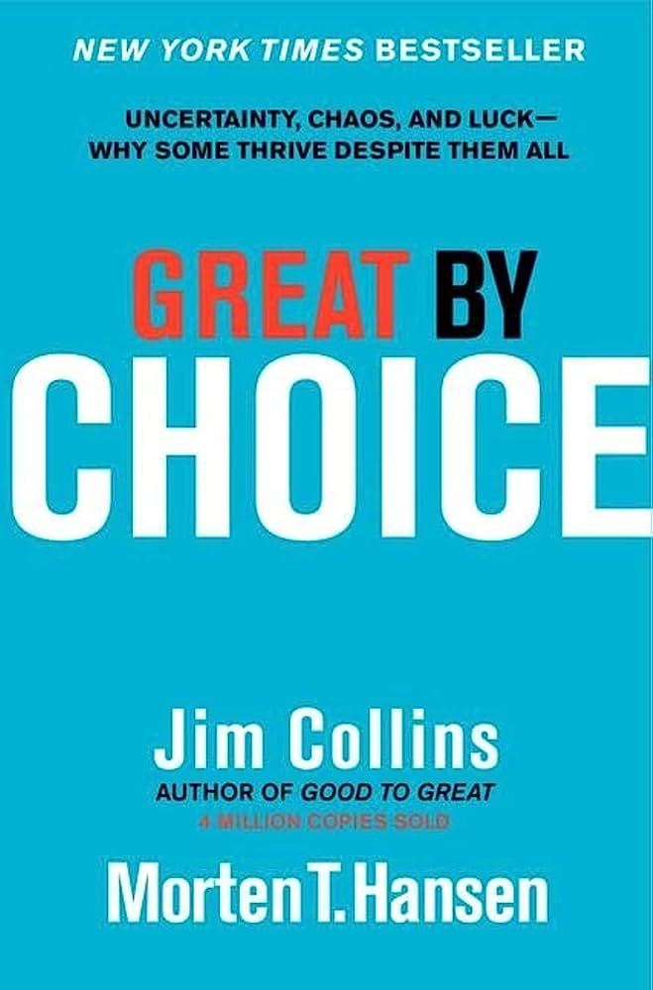
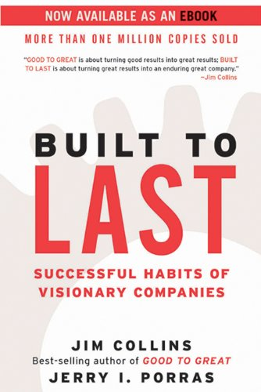
The difference between a good leader and a great leader is humility. Author: James C. Collins If something is GOOD, you must convince and sell it to others. If something is GREAT, people will automatically flock to it.
Notes:
Script: Tiers I, II, III
Facilitator:
For us to demonstrate our belief around “life-long learning” it is important to explore resources that can challenge and expand our thinking. At CHARGE, one year, we all read Good to Great. We learned about things like hedgehogs and flywheels. Jim Collins studies companies from around the world and identifies the characteristics that make them an outstanding company. Much of what he has found can be applied to school systems. We are going to examine some key concepts from four of his books.
Facilitator may choose to have participants respond to one or more of the following prompts. Note that the configuration for each prompt is different. It is your choice as to how you would like to set up groups.
Discussion Points:
Ask participants to work in pairs to discuss one or more of the following (facilitator’s choice):
101 - Choose one of the two quotes from the slide and discuss how it applies to leadership, high standards, and Clovis Unified. Be prepared to share with the group.
201 - Clovis Unified has been called a destination school district. Identify 1-2 reasons that families move to our district. What are the desirous characteristics/qualities inherent in your identified reasons?
301 – Discuss the differences between good and great. In your group come to a consensus…is CUSD a good or a great school district? If CUSD is great, what data did you use to make that determination. If CUSD is good what needs to be done to move to great?

Slide 5
Built to Last Successful habits of visionary companies
“the visionary companies studied need to continually remind themselves of the crucial distinction between core and non-core, between what should never change and what should be open for change, between what is truly sacred and what is not”
Built to Last p. xx
Notes:
Script: Tier I, II, III
Facilitator:
Built To Last examines what lies behind the extraordinary success of 18 companies and which principles and ideas they’ve used to thrive for a century (summary is available in the resource folder).
Discussion Points
Facilitator may choose how to discuss (pairs, triad, small or whole group)
101 –How does this quote from Built to Last apply to Clovis Unified school district? Identify the core components of the CUSD educational system.
202 – Identify what should never change in our district because they are sacred to who we are. Explain why they should never change.
303 – Identify those things that should be open to change, it is not sacred. Explain what should be changed and describe how it should be different or perhaps eliminated.
As groups finish their conversations ask them to share with large group.

Slide 6
Great by Choice
Myth: Successful leaders in a turbulent world are bold, risk-seeking visionaries.
Finding: The best leaders did not have a visionary ability to predict the future. They observed what worked, figured out why it worked, and built upon proven foundations. They were not more risk taking, more visionary, and more creative than the comparisons. They were more disciplined, more empirical, and more paranoid.
Great by Choice, p. 9
Notes:
Script: Tier I, II, III
Facilitator:
Great By Choice analyzes what makes the world’s best companies thrive in even the most uncertain and chaotic times, by distilling nine years of research and great stories into three actionable principles (summary available in resource folder). Let’s look at one of the myths verses the actual finding. Facilitator read the screen.
Turn to a neighbor and discuss one or more of the following (facilitator’s choice):
101 – Discuss the differences and similarities between the myth and the finding. Jot them down to share with the group.
201 – Thinking about a leader you believe to be bold; risk-seeking and visionary describe their characteristics with examples. No need to name the person. Do you consider this person to be successful? Explain why or why not.
301 – Thinking about a leader you believe to be disciplined, uses data, and is a little paranoid. Again, no names. Do you consider this person to be successful? Explain why or why not. Which leader would you rather follow? Explain why.
As discussions end ask each group to share with the larger group.

Slide 7
Be 2.0 Turning your business into an enduring company
How does the following statement apply to Clovis Unified?
The right people in key seats understand that they don’t have “jobs”; they have responsibilities. They grasp the difference between their task list and their true responsibilities. A great doctor doesn’t merely have the “job” of performing procedures but embraces responsibility for the health of the patient. A great coach doesn’t merely have the “job” of preparing workouts but embraces the responsibility for building his or her players into better people. A great teacher doesn’t merely have the “job” of being in the classroom from 8 A.M. to 3 P.M. but embraces responsibility for every child’s learning.
Be 2.0, p.19
Notes:
Script: Tier I, II, III
Facilitator:
Listen to this description of the book BE 2.0…This book is about how to turn an existing enterprise into an enduring great company. We’ve written for people who want their company to be something special, worthy of admiration and pride. Our focus is on helping them build an extraordinary organization, one that sustains high performance, plays a leadership role in shaping its industry, rises to the status of role model, and remains great for generations. I think this might be the book for us!
When Steve Weil was interviewed for the Leadership Academy he talked about holding ourselves to high standards academically, morally, emotionally, ethically. High standards in terms of how you treat each other and how you demonstrate respect and character. He goes on to say, high standards go across the foundation of CUSD for students, staff, and community. It's not just high-test scores, it's not just a winning championships. High standards permeate all that we do as a Unified District every day and all the time. How many of you agree with Steve’s comments. I certainly hope this is still true for our organization.
In job alike groups discuss one of more of the following:
101 - Does the organizational system help or hinder CUSD becoming a great school district?
201 - What would need to change at your school/department for CUSD to become a great district? Or is already great? If so, how do you know? Use facts/data to justify your response.
301 – What would need to change at the district level for each school/area/department for CUSD to become a great district? Or is already great? If so, how do you know? Use facts/data to justify your response.
Share out with lthe arger group as discussion end.

Slide 8
Good to Great Why Some Companies Make the Leap… and Others Don’t
“The good-to-great leaders seem to have come from Mars. Self-effacing, quiet, reserved, even shy-these leaders are a paradoxical blend of personal humility and professional will. They are more like Lincoln and Socrates than Patton or Caesar. ”
Good to Great, p.12
Notes:
Script: Tier I, II, III
Facilitator:
Jim Collins studies companies from around the world and identifies the characteristics that make them an outstanding company. For his book. Good to Great Collins and his research team identified a set of elite companies that made the leap to great results and sustained those results for at least fifteen years. Today we are going to look at what Collins has to say about the leadership of a good company that transitioned too great.
Please read the Chapter Summary for Level 5 Leadership from the book Good to Great (available in resource folder).
Discussion Points:
After reading the chapter summary form a small group of three (facilitator's choice) to discuss one or more of the following (facilitators choice).
101 – Looking at the summary notice the characteristics of Level 5 leaders according to Collins. Choose 1-2 characteristics and describe a leader who demonstrates those characteristics. What did you hear/see that made you choose that leader?
201 – Looking at the summary which of the 9 key points most surprised you? Explain why? Identify the strengths and weaknesses of each level providing specific examples.
301 - Now, think about yourself as a leader. Looking at the nine key points which one represents where you are in your leadership journey? Explain why.
As groups finish their conversations ask them to share with large group.

Slide 9
Level 5 Leaders Good to Great, p. 39
Possess personal humility and professional will.
Set up successors for even greater success in the next generation.
Display modesty, are self-effacing, and understated.
Are fanatically driven with a need to produce sustained results.
Demonstrate workmanlike diligence – more plow horse than show horse.
Look out the window to attribute success to factors other than themselves.
When things go poorly, they look in the mirror and blame themselves.
Notes:
Script: Tier I, II, III
Facilitator:
Jim Collins studies companies from around the world and identifies the characteristics that make them an outstanding company. For his book. Good to Great Collins and his research team identified a set of elite companies that made the leap to great results and sustained those results for at least fifteen years. Today we are going to look at what Collins has to say about the leadership of a good company that transitioned too great.
Please read the Chapter Summary on pages 39-40 for Level 5 Leadership Key Points from the book Good to Great (available in resource folder). Good to Great was written 2001, over twenty years ago; turn to a neighbor and discuss if the leadership attributes described by Collins are still valid today in Clovis Unified. Explain your thinking with examples. Be prepared to share with larger group. Allow about 10 minutes for discussion and 10 for each pair to share (facilitator’s choice).
Discussion Points:
After reading and discussing the attributes of a Level 5 leader form a small group of three (facilitator's choice) to discuss one or more of the following (facilitators choice).
101 – Looking at the summary notice the characteristics of Level 5 leaders according to Collins. Choose 1-2 characteristics and describe a leader who demonstrates those characteristics. What did you hear/see that made you choose that leader?
201 – Looking at the summary which of the key points most surprised you? Explain why? Identify the strengths and weaknesses of each level providing specific examples.
301 - Now, think about yourself as a leader. Looking at the key points which one represents where you are in your leadership journey? Explain why.
As groups finish their conversations ask them to share with large group.

